Slide 1


NBA Draft: The Right Pick
River Yan

Slide 2
Overview
- Data analysis methodology used to evaluate how NBA teams have performed in each draft and seeing if there are other players valued at a lower pick.
How effective did NBA teams draft players in each draft?

Slide 3
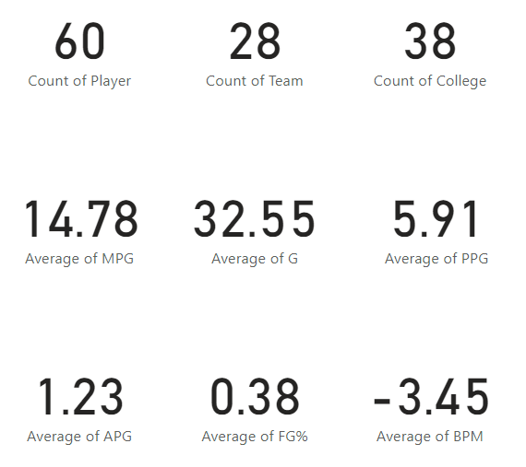
2019 Overall Dashboard
*Note: Averages contain players with values of zero which may impact the overall calculation.

Slide 4
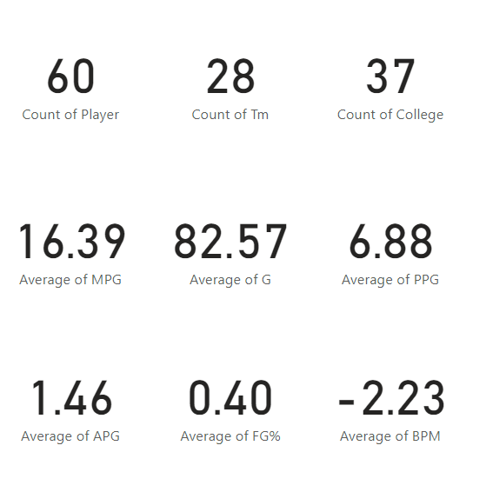
2018 Dashboard

Slide 5
Timeline
Analysis
Visualize
Evaluate

Slide 6
Data Filtering
Change blank stats to zero
Changed blank colleges to none
Just 2019 now but can expand to 2018 and beyond
Added ranks for each column
Summed up the ranks of each column
Create a final rank column where 1 is the lowest sum of ranks and 60 is the highest sum of ranks

Slide 7
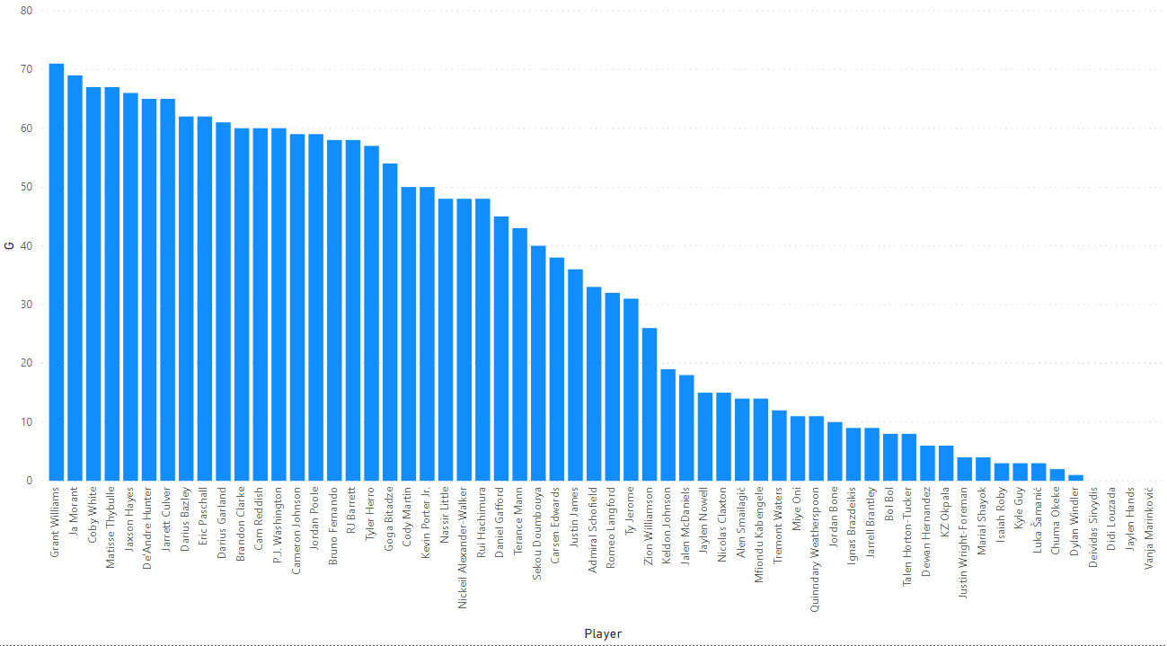
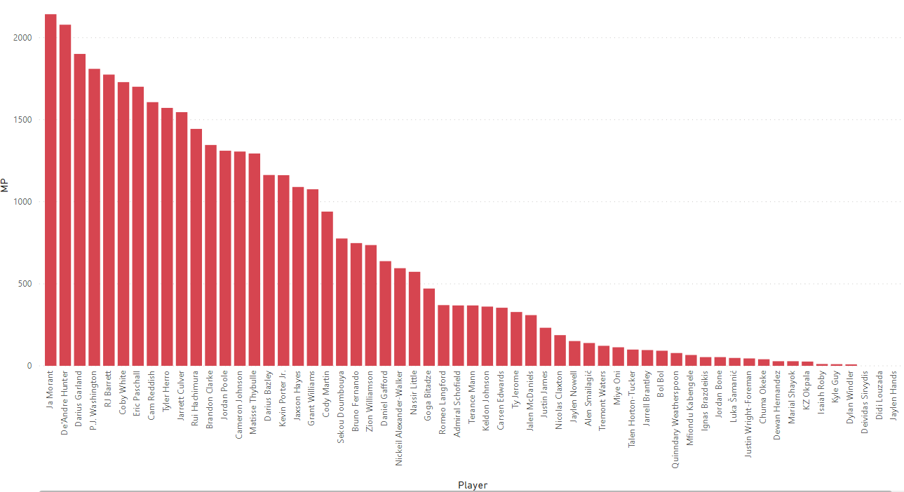
Preliminary Analysis

Slide 8
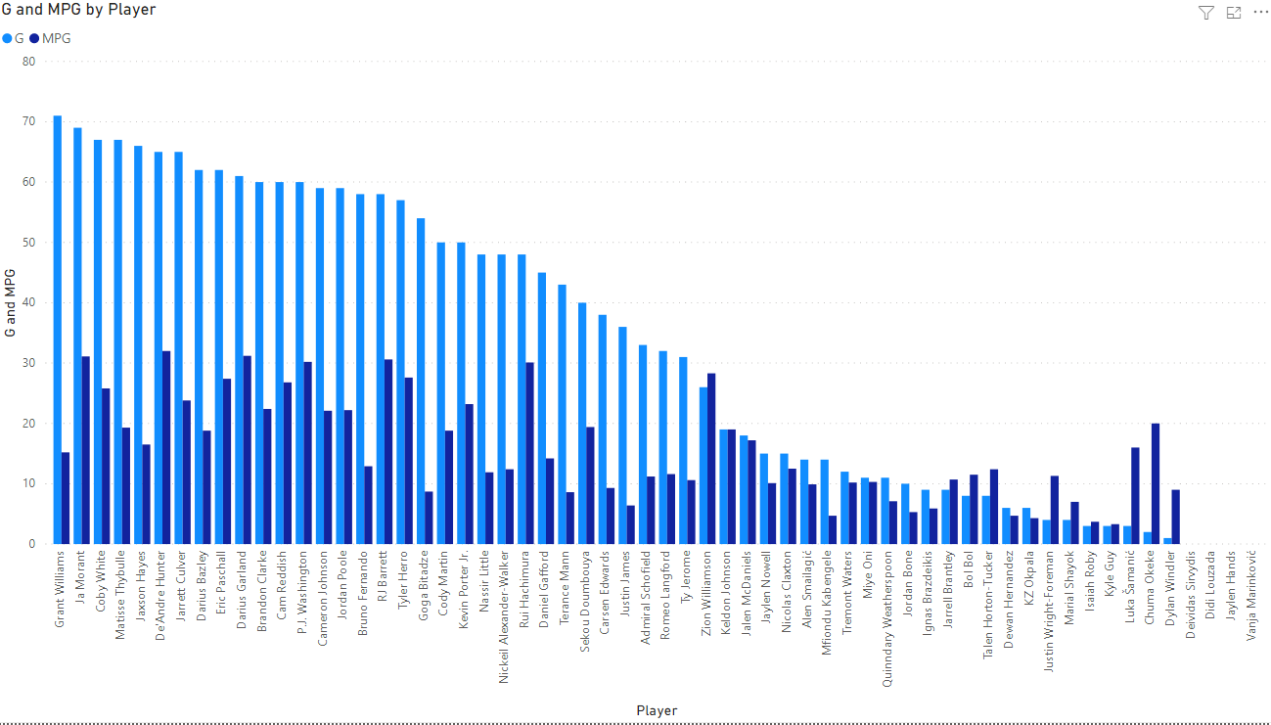
Games & Minutes Per Player

Slide 9
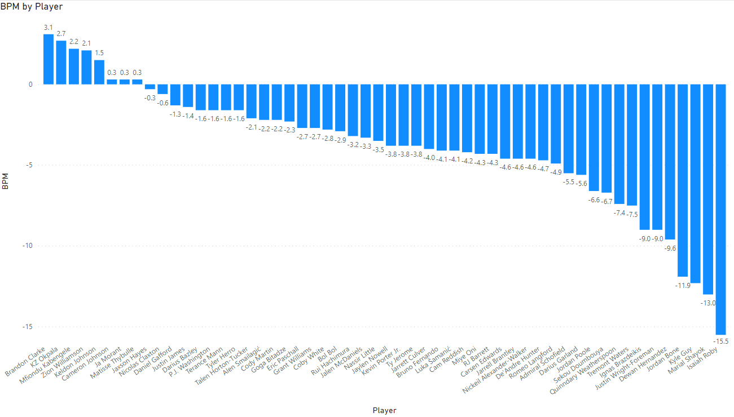
+/-
* Plus-minus is a basketball statistic that shows point differential when that certain player is on the court.

Slide 10
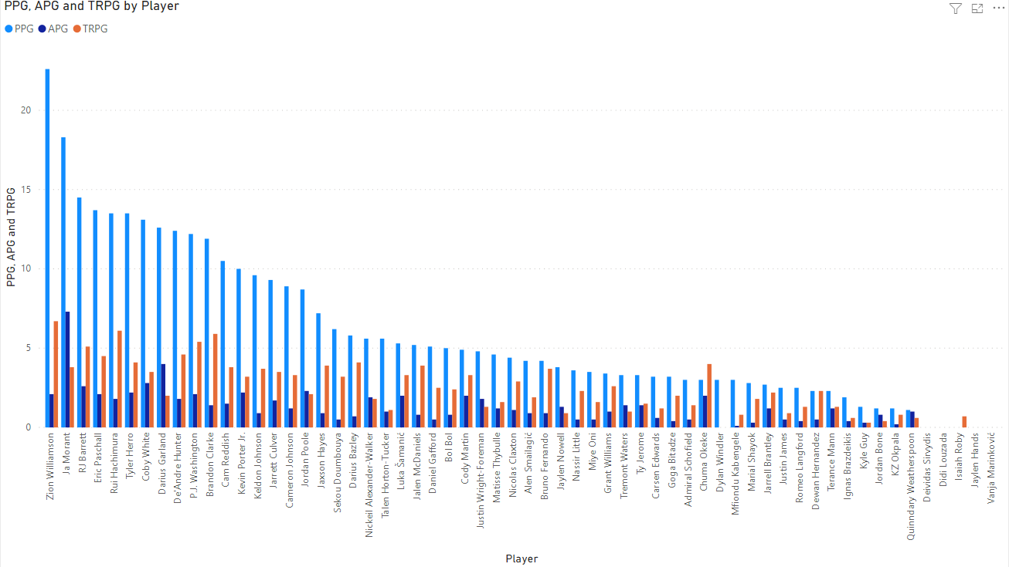
Points, Assists, & Rebounds

Slide 11
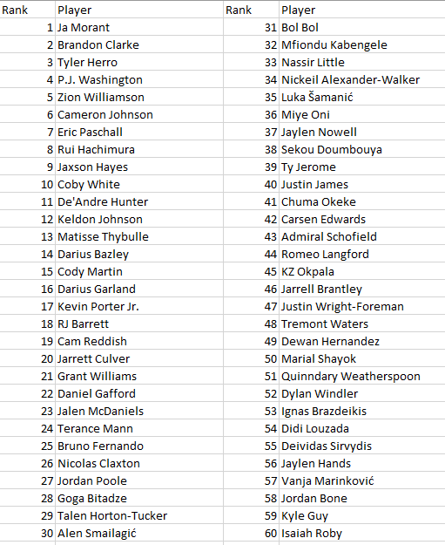
Initial Player Findings

Slide 12
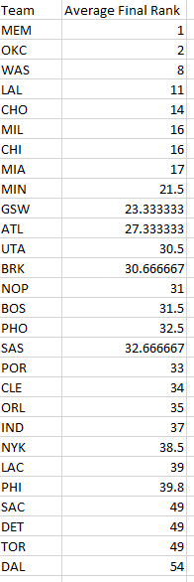
2019 Initial Team Rankings
- Different teams have a different number of picks so it is important to put that into consideration.

Slide 13
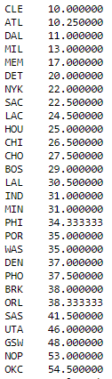
2018 Team Rankings
- Memphis is also in the top 5 after being the best team in 2019.
-

Slide 14
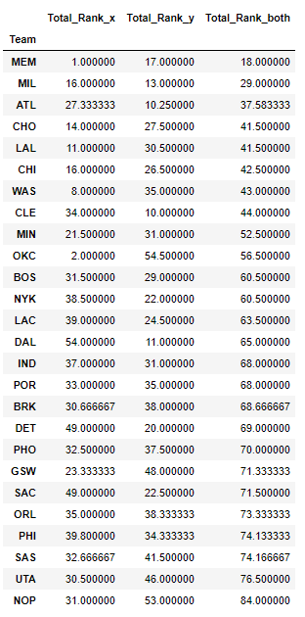
2018/2019 Comparison
- Merged two datasets
- Findings:
1. Memphis has had two solid drafts making them the best team out of the two years.
2. The Bucks have had two average drafts as they did about the same in the two years.
3. There is also a pattern where teams in one year draft well but then in the other year they draft much worse.

Slide 15
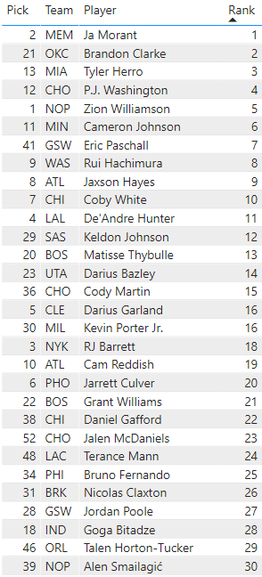
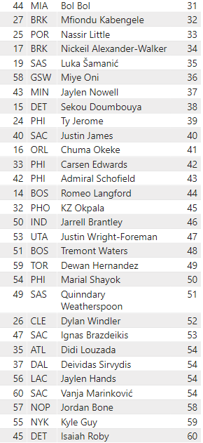
Evaluation
The Grizzlies couldn’t have done better with Ja Morant at the 2nd pick because he has the best rank.
Brandon Clarke has a lot of value at pick 21 where he has the second best rank.
The Knicks could have done a better job drafting RJ Barrett with the third pick but his rank was 18th pick.

Slide 16
Feature Importance
Minutes
Points
Assists
Total rebounds
Games
*Used SelectKBest and Chi-Squared from Sklearn

Slide 17
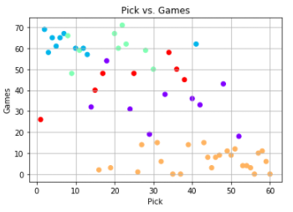
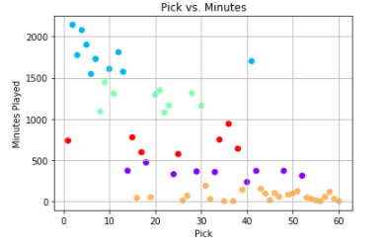
K-Means Clustering
K-Means Clustering in grouping observations into clusters based on the closest mean.
Picks vs. Minutes are the best features for this clustering method.

Slide 18
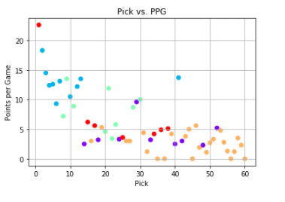
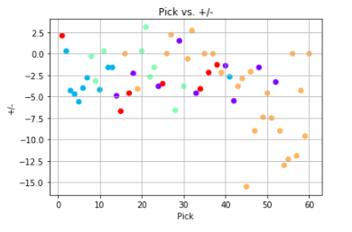
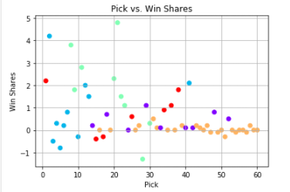
K-Means Clustering Findings
*Looking at these scatterplots, we can see that there are some great finds with later picks compared to higher picks. K-Means makes easier to see the low values of low picks and the generally high values with the higher picks.

Slide 19
Outcomes

